Slide 1
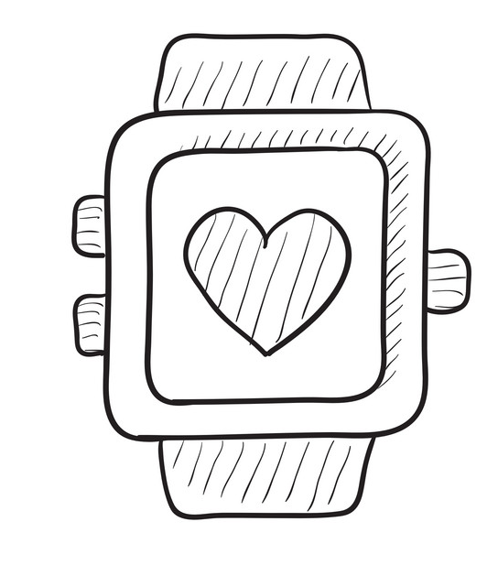
Wearable Device and Edge Computing for Patient Recovery
Internship Demo
Yuanjun Zhang, Peng Du
Friday, August 26, 2022

Slide 2


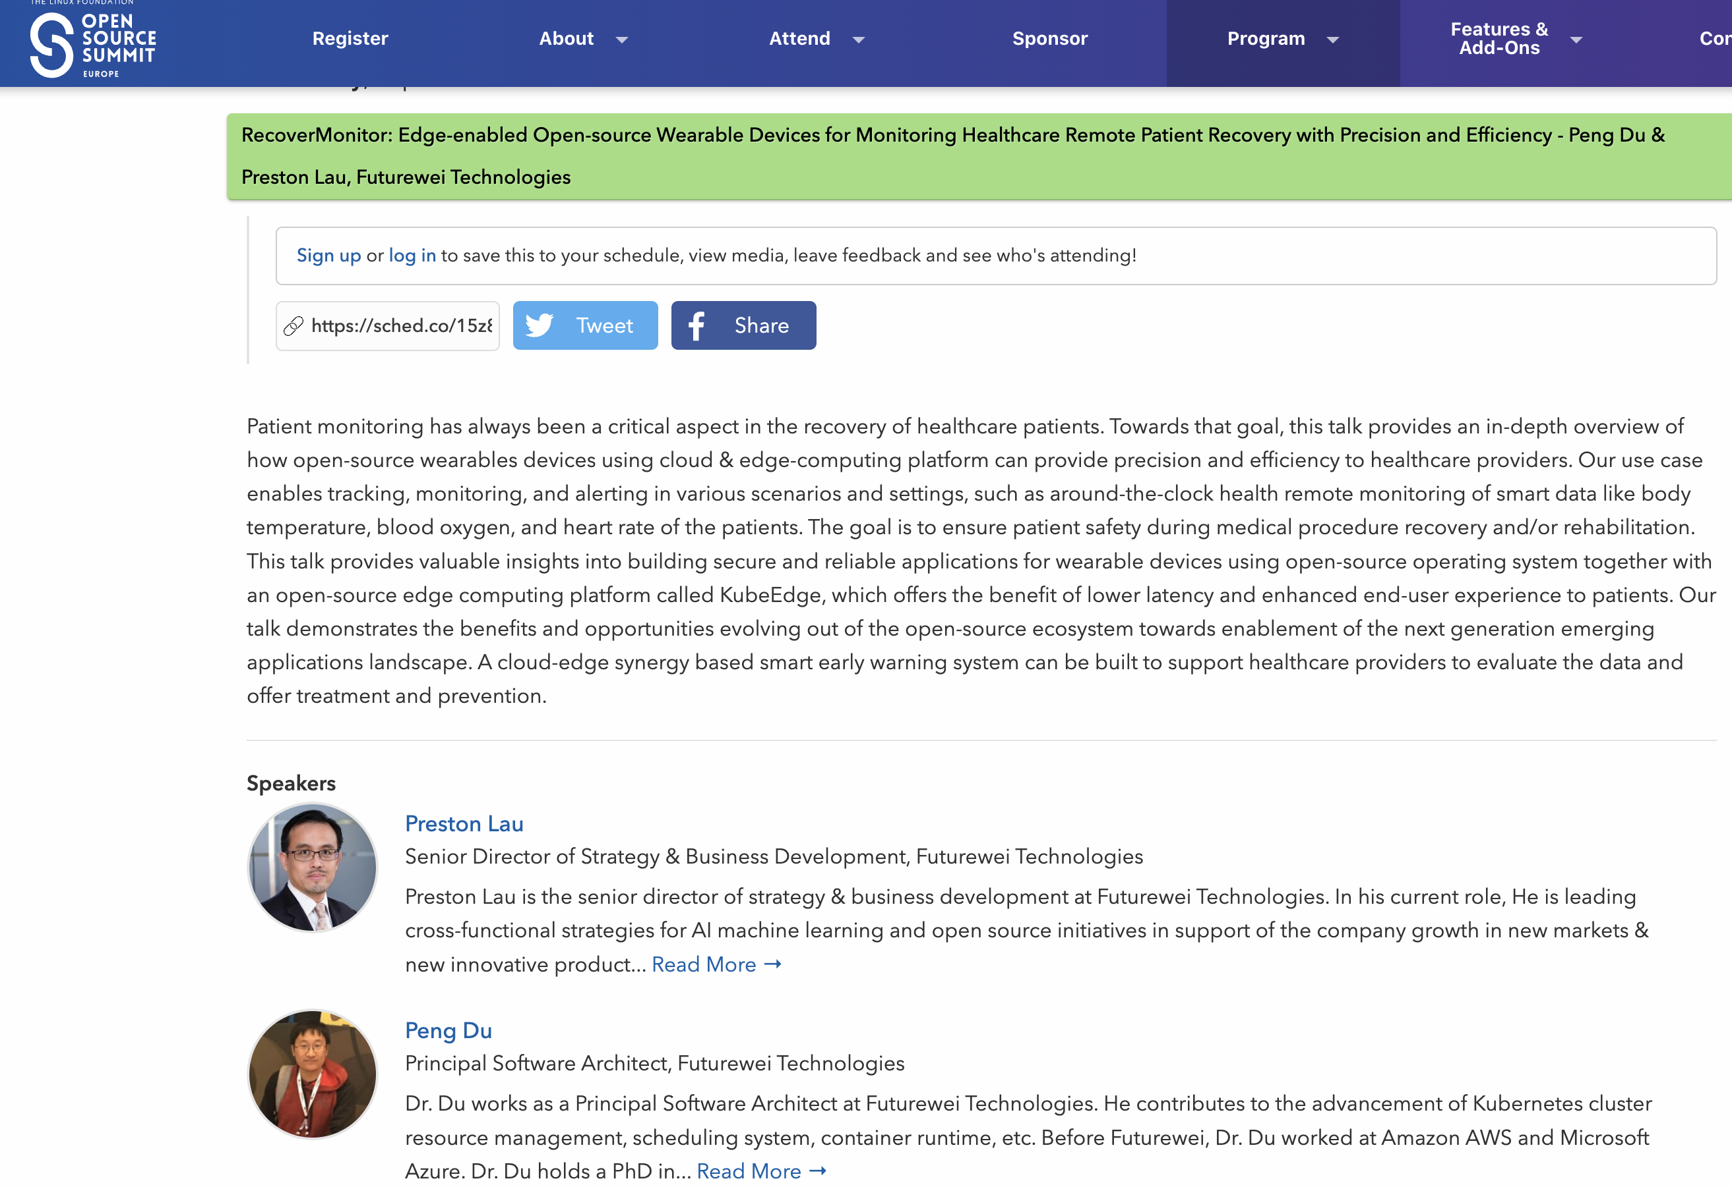


Cross-lab & Community Effort
B
Open Source Summit Europe in September
Cloud Lab: Edge Computing
Strategy and Business Development: Wearable Device
B
Engineering and Mathematics at UW Bothell
Neurological Surgery at UW Seattle

Slide 3
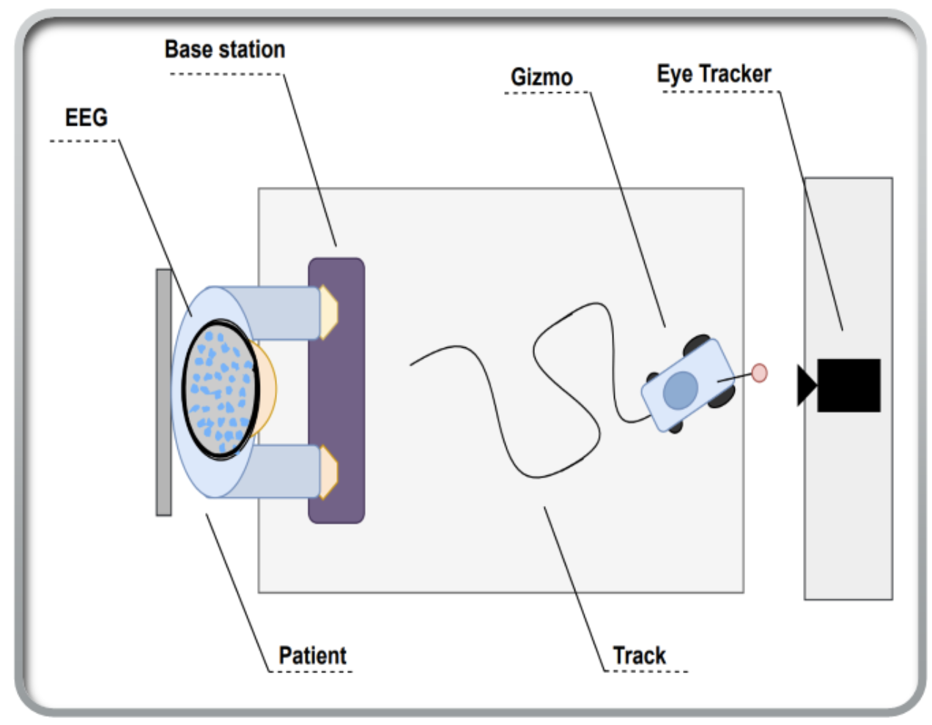


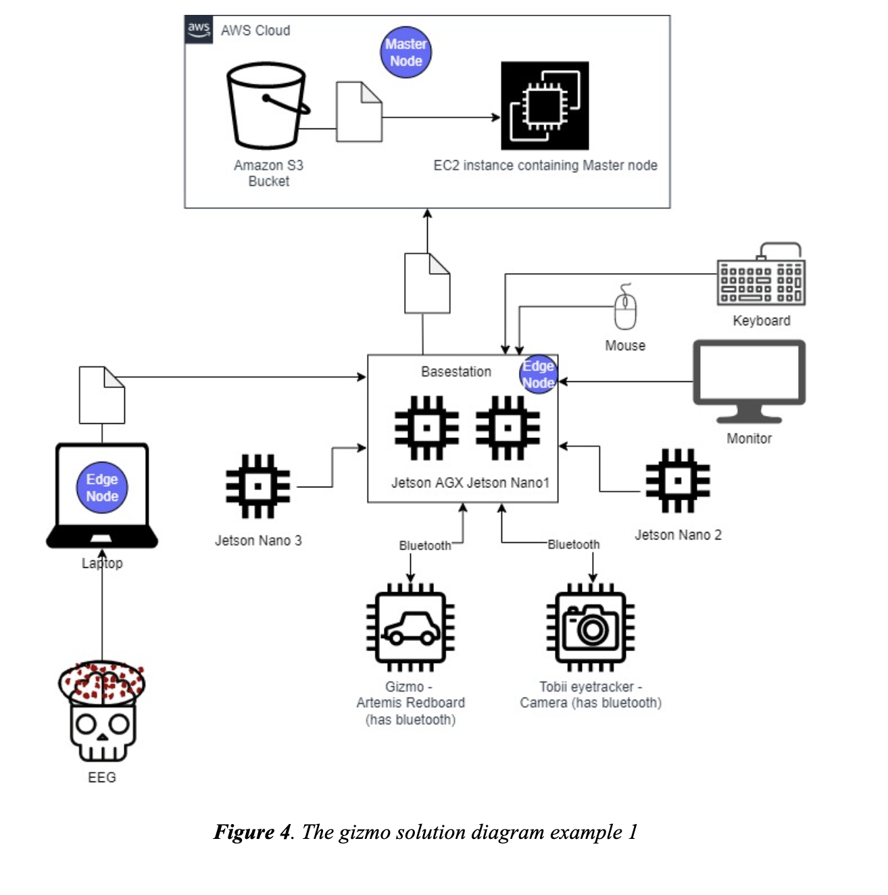
Motivation
Public Cloud
Cloud Compute
Cloud Storage
Stroke Rehabilitation Project
Patient house
hospital
Base station
Gismo
EGG
Eye tracing & processing
Edge Compute
From “Final Report - Edge Computing Team” by UW Students
Edge Compute Control Plane

Slide 4
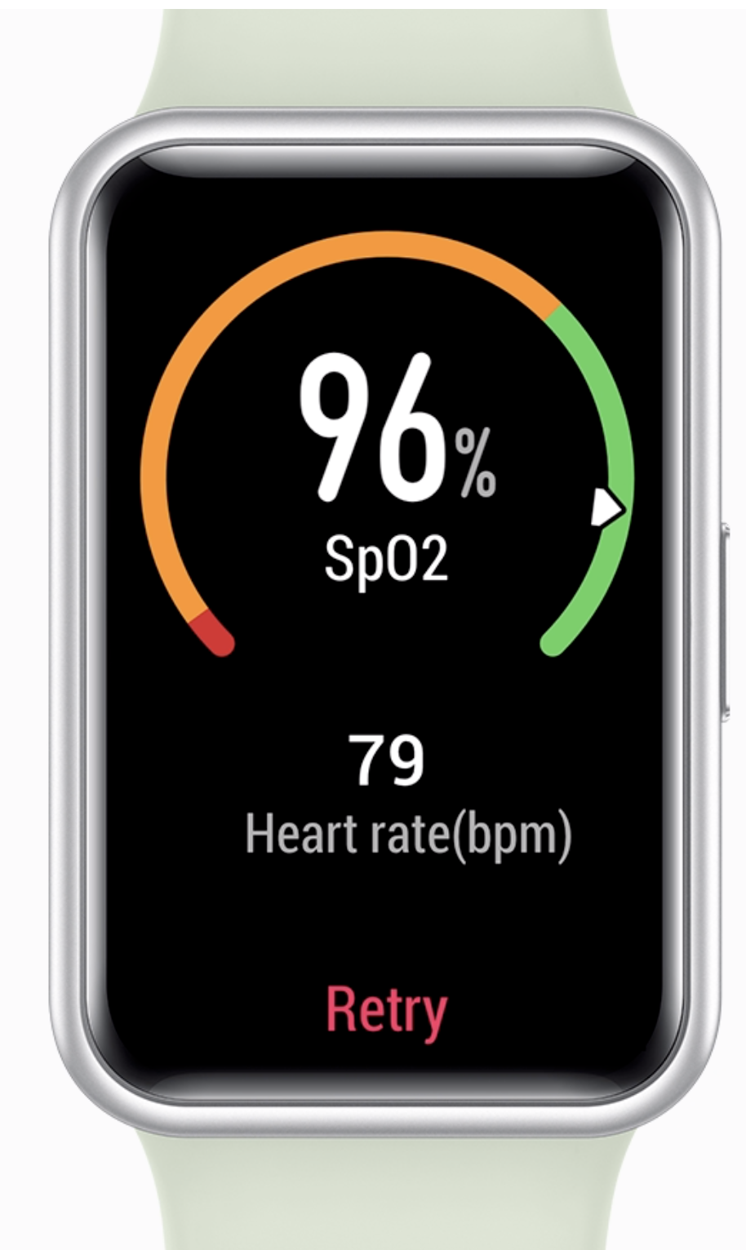


Internship Period: 7 weeks (1.75 months)
Strategy & Goals:
Focus on end-to-end setup following the data flow
Documentation for cross-team sharing
Public Cloud
Cloud Compute
Edge (e.g.) hospital
Cloud APP
Edge APP
Cleansing
Pre-processing
Cloud Storage
Backup
Post-processing
Training DB
1
2
3

Slide 5
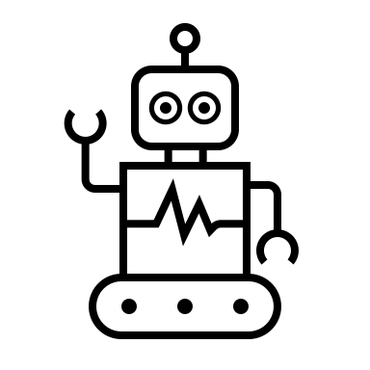
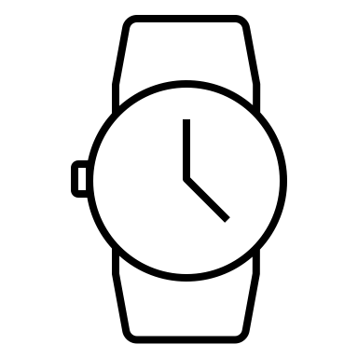
Design & Architecture
Public Cloud (e.g. AWS)
Cloud Control Plane
Cloud Worker
trained model
Model training
Federated Learning
Cloud Storage
Data backup
Data Warehouse
Edge Node
Data cleansing
Model inferencing
cleaned sensor data
sensor data
Edge Node

Slide 6
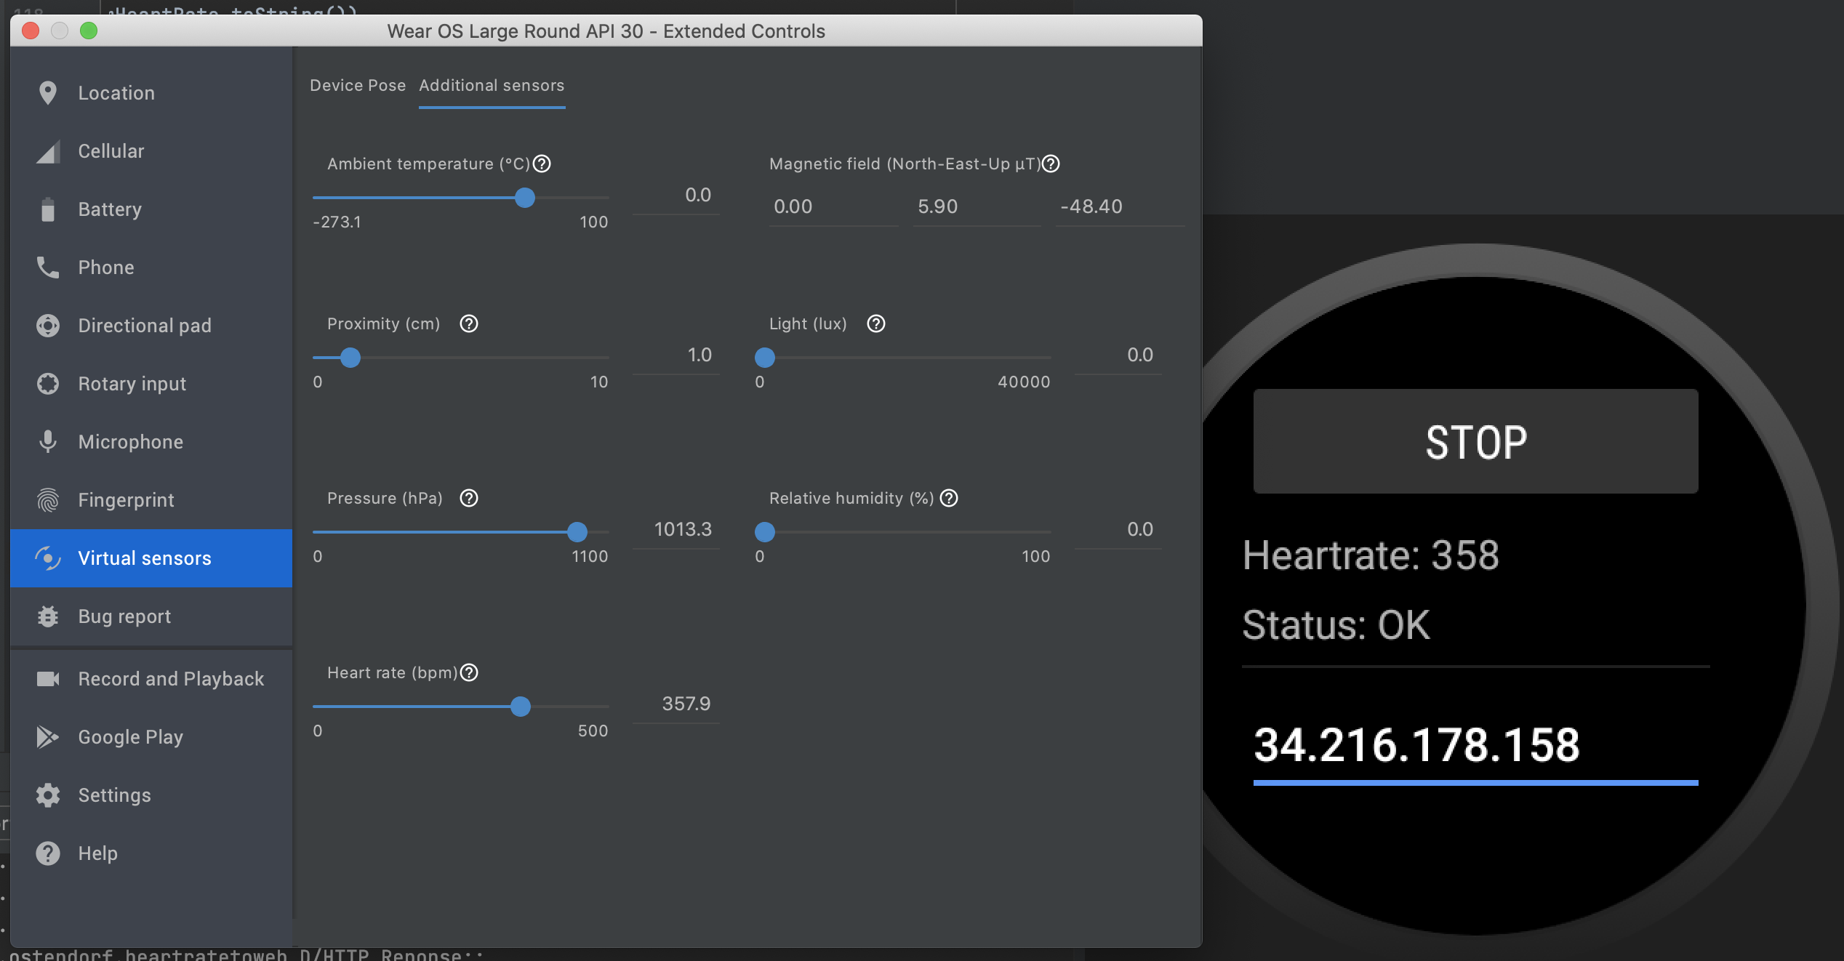
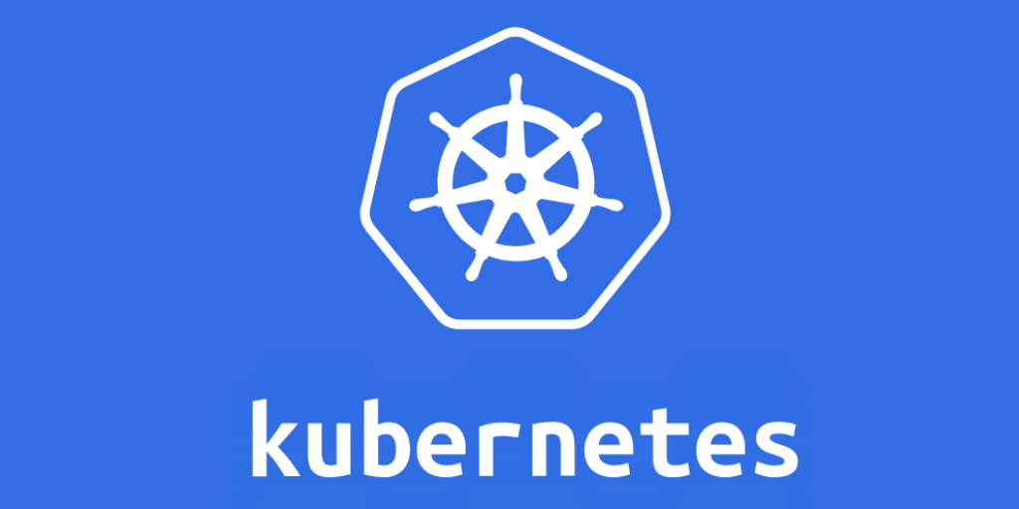

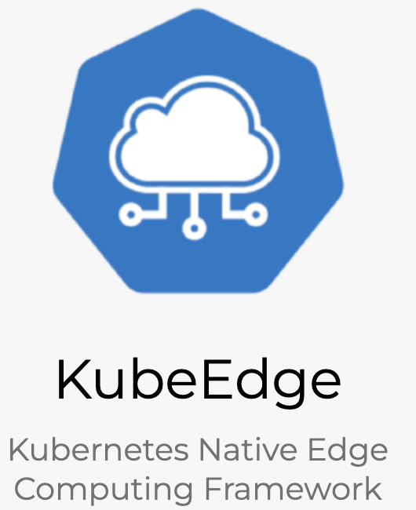


Dev Environment
Wearable Device
Cloud Control & Compute
Edge Computing
Cloud Storage

Slide 7
Wearable device generate data and send to the ‘Edge’
Edge APP
Cleansing
Pre-processing
Edge Node
1
2

Slide 8
The data flow from ‘Edge’ to ‘Cloud’
Cloud APP
Edge APP
Edge Node
Cloud Storage
(S3)
Cloud Worker

Slide 9
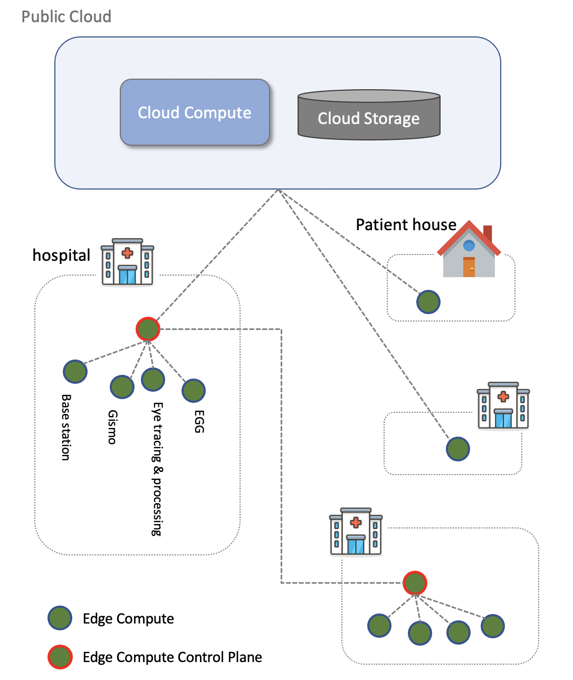
Next Steps
Infra (FW):
Edge Node → Edge Cluster (Fornax)
Edge-edge direct communication
Application (FW+UWB)
Sensor types++
AI application
Patient recovery monitoring e2e

Slide 10
Summary
Docker/Containerd
Dockerfile
Image conversion
KubeEdge
Cloud- and edge-core
keadm
K8s
Apiserver/scheduler/controller
Kubeadm/Kubelet/Kubectl
Networking: Flannel/DNS in Pod (8.8.8.8)
Host volume
Workload: Pod, Deployment
Coding
Golang/Python
Test drive development
AWS
EC2, S3
CLI
Documentation

Slide 11
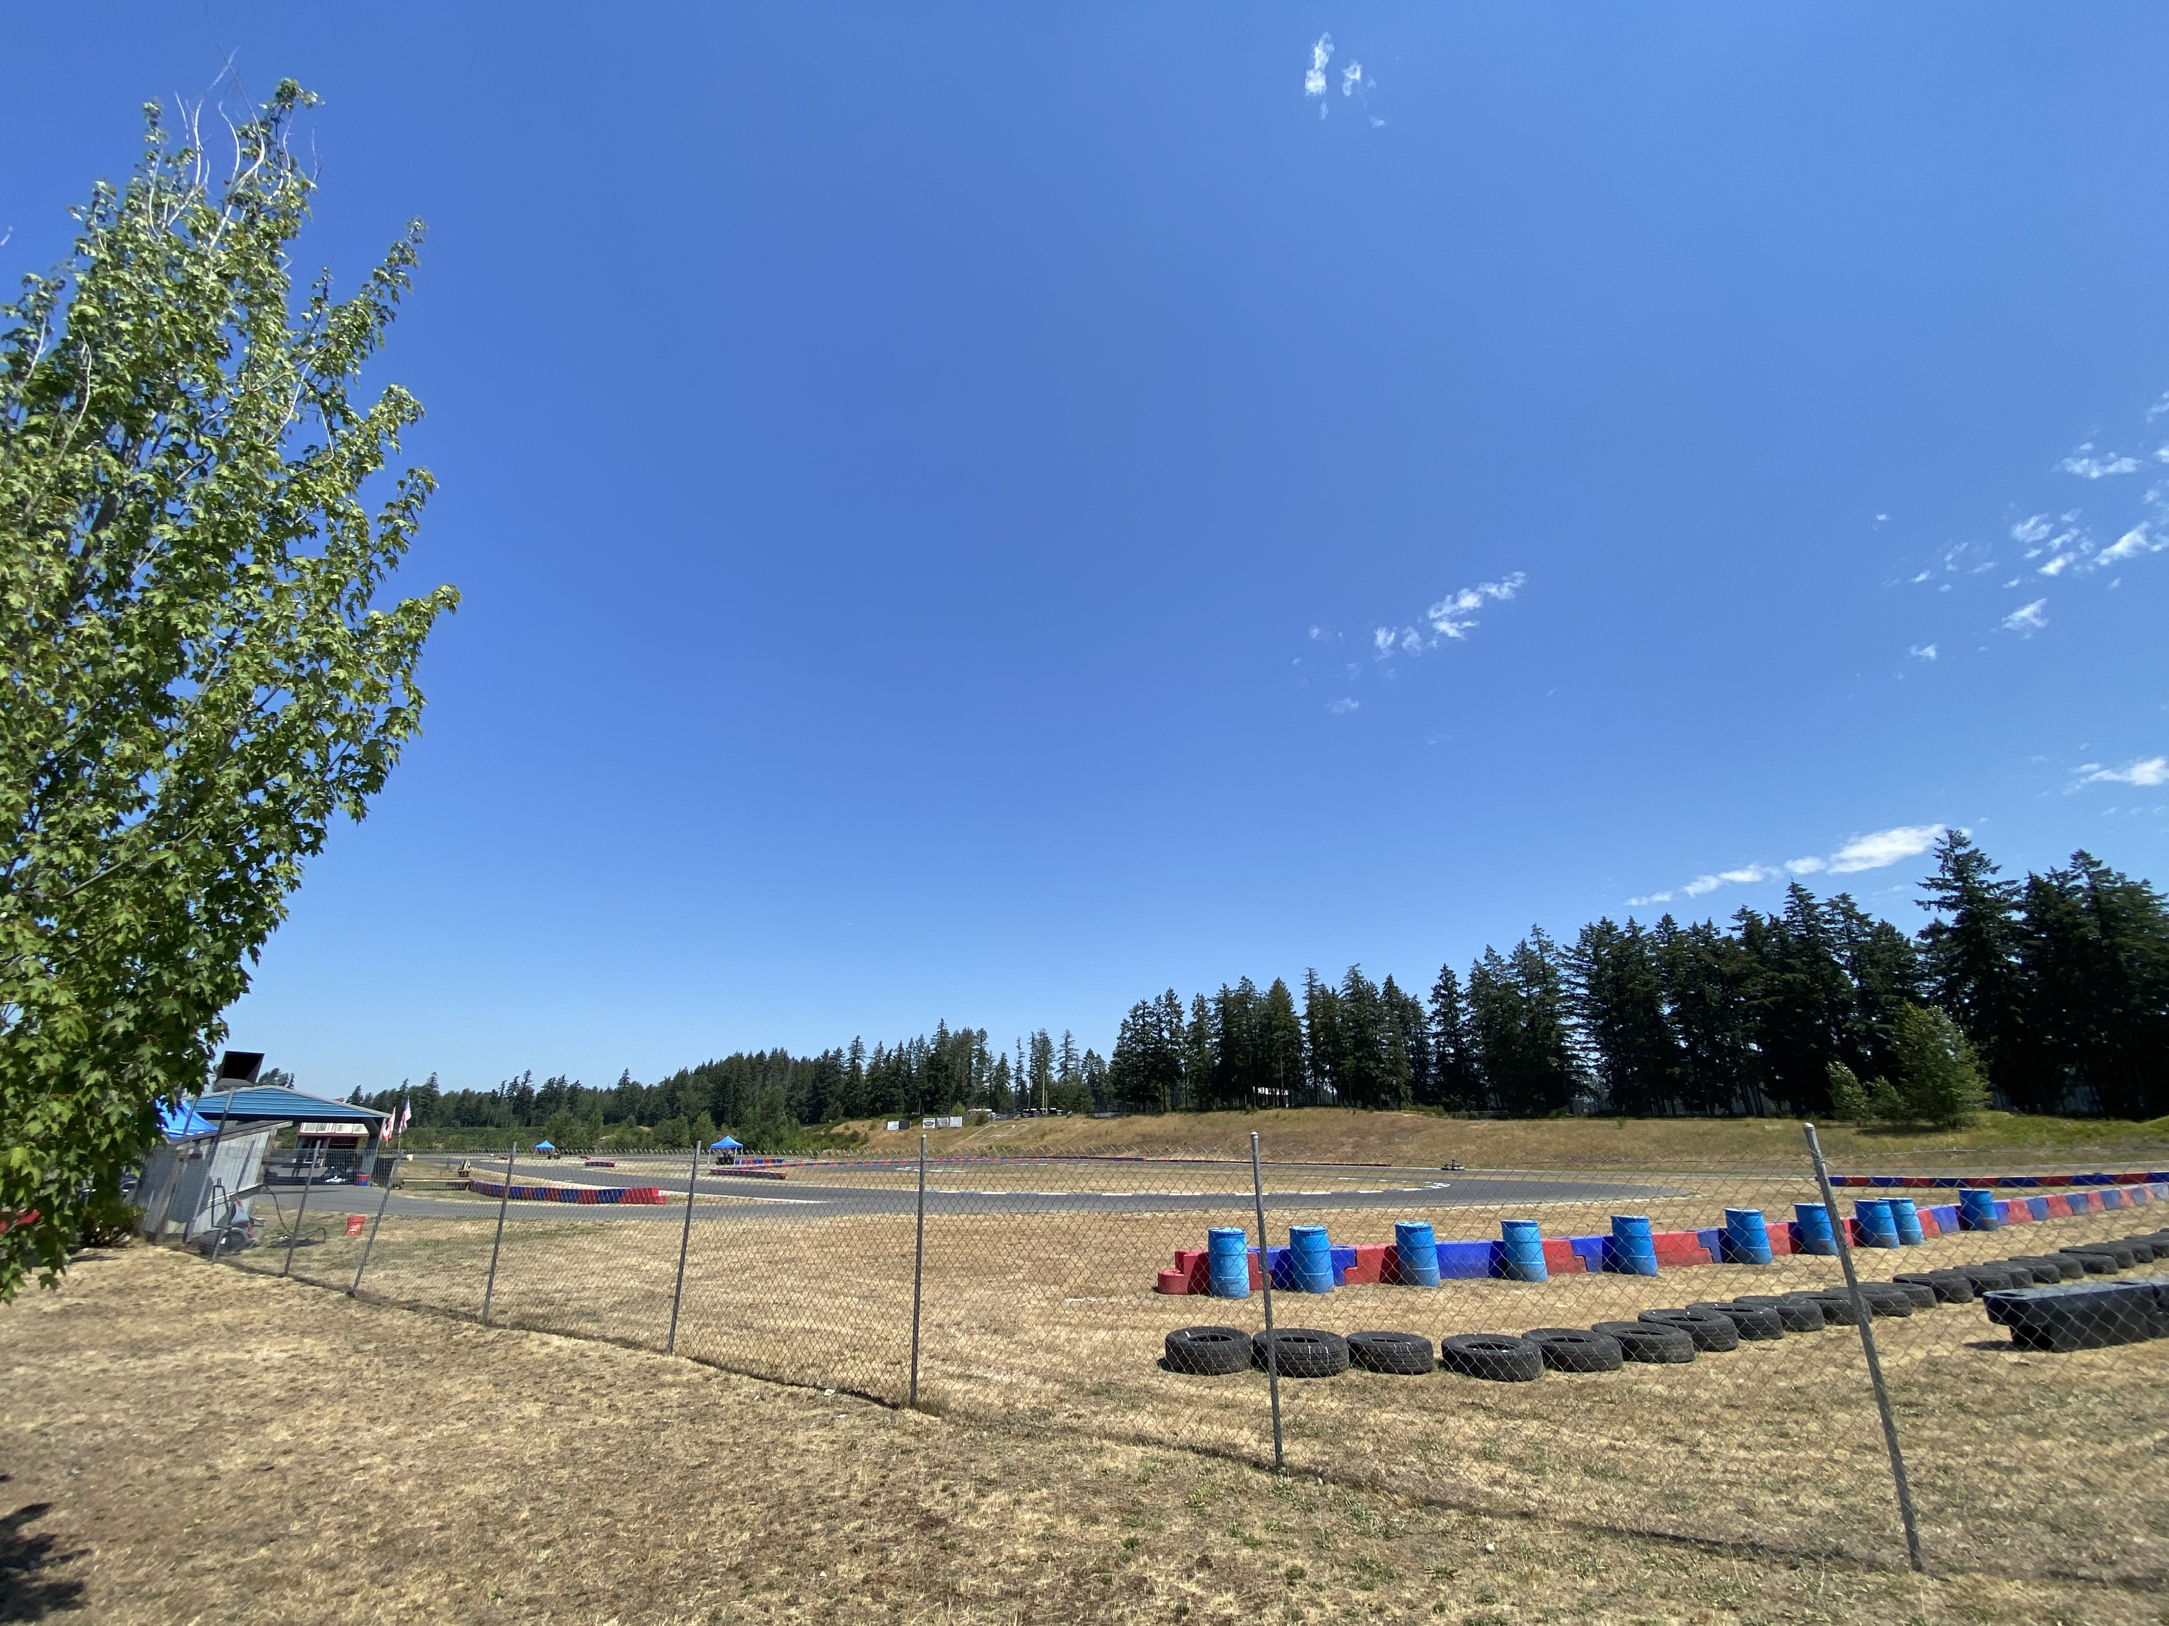
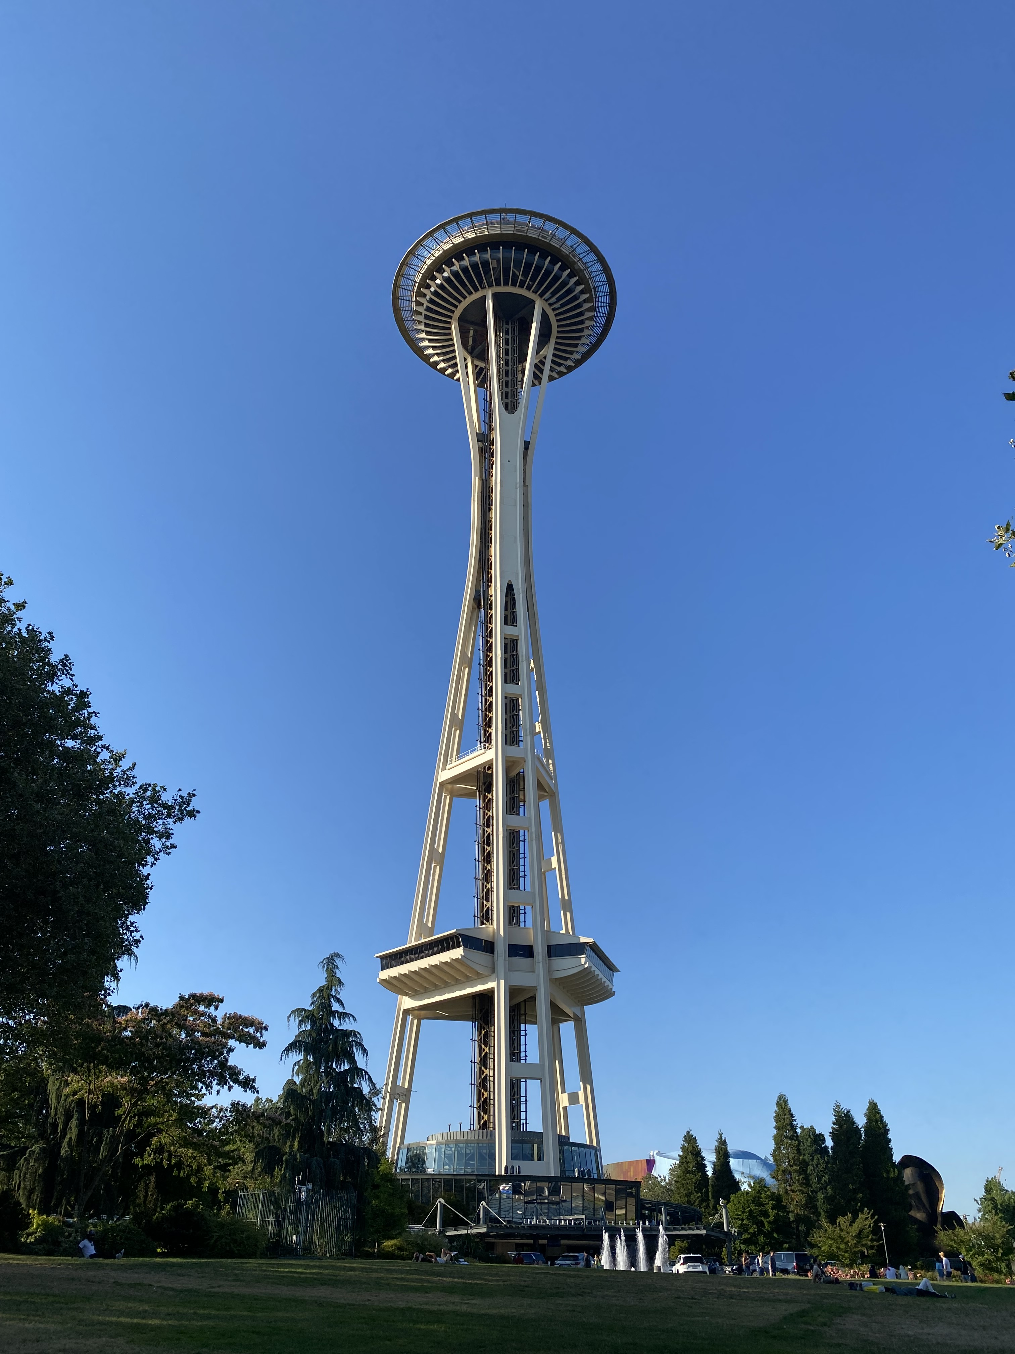

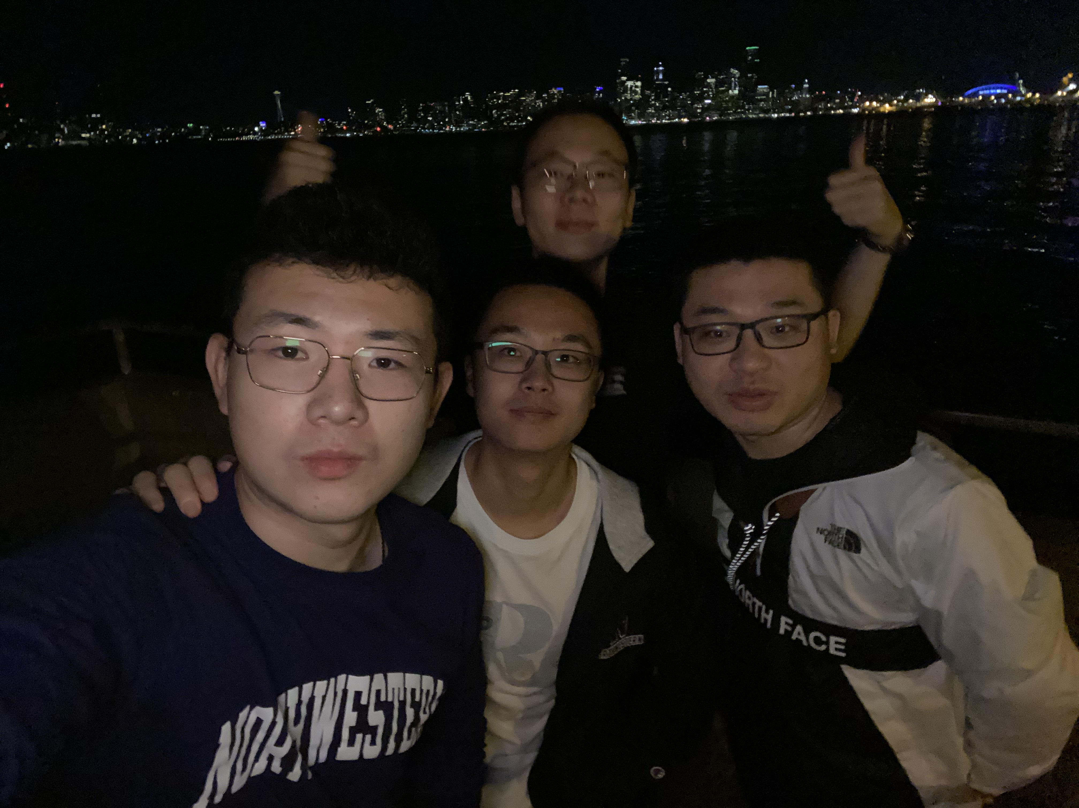
Intern Experience

